Slide 1

South Atlanta High School
Notes:
Good Morning/Afternoon! Today we begin the process of planning our school’s budget for FY23. I know we are all here for the same reason and that is ensuring success for all (enter school name) students. This meeting is to provide an overview of the draft budget and for you to give feedback on the draft budget.

Slide 2
Norms
This is a meeting of the GO Team. Only members of the team may participate in the discussion. Any members of the public present are here to quietly observe.
We will follow the agenda as noticed to the public and stay on task.
We invite and welcome contributions of every member and listen to each other.
We will respect all ideas and assume good intentions.

Slide 3

GO Team Budget Development Process
YOUR SCHOOL STRATEGIC PLAN…
is your roadmap and your role.
It is your direction, your priorities, your vision, your present, your future.
Step 1: Data Review
Step 2: Strategic Plan Review
Step 3: Budget Parameters
(Strategic Priorities)
Step 4: Budget Choices
Notes:
Today I will provide an overview of the budget allocations for FY23. We will begin the work of funding the strategic priorities we agreed upon during our strategic review meeting. (IF YOU HAVE NOT DECIDED ON YOUR PRIORITIES, YOU WILL SAY – WE WILL DECIDE ON OUR PRIORITIES AND THEN DISCUSS ALLOCATING FUNDS TO ADDRESS THOSE PRIORITIES).

Slide 4
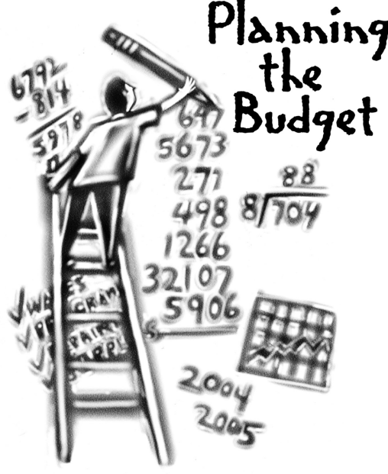
Overview of FY ‘24 GO Team Budget Process
Step 1 Review and Update Strategic Plan and Rank Strategic Priorities
By end of Fall Semester
Step 6 Principals: HR Staffing Conferences Begin
Late February – Early March
Step 3 GO Team Initial Budget Session: Allocation
January 24 – early February
Step 7 GO Team Final Budget Approval Meeting
Budgets Approved by March 17
Step 5
GO Team Feedback Session: Draft Budget Presented & Discussed February – multiple meetings, if necessary
Step 4 Principals: Associate Supt. Discussions and Review
February (supports needed, specific challenges, coaching)
Step 2 Principals: Workshop FY 24 Budget
January 24
GO Teams are encouraged to have ongoing conversations

Slide 5
Budget Allocation Meeting
What
The first GO Team meeting is when the principal will provide an overview of the budget allocation for GO Team members and the general public.
Why
This meeting provides an opportunity for the principal and GO Team to ensure alignment on the school’s key strategic priorities, gain a deeper understanding of the budget allocation, and provide input to drive the direction of the draft budget.
When
End of January- Early February

Slide 6
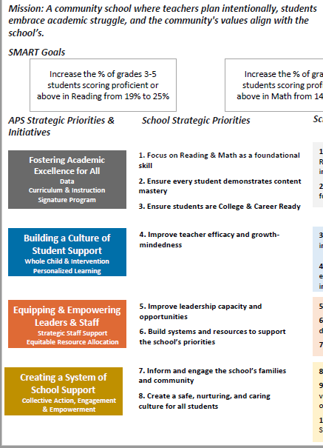
FY24 Budget Development Process
Principal’s Role
Design the budget and propose operational changes that can raise student achievement
Flesh out strategies, implement and manage them at the school level
Focus on the day-to-day operations
Serve as the expert on the school
Hire quality instructional and support personnel
The GO Team’s Role
Focus on the big picture (positions and resources, not people)
Ensure that the budget is aligned to the school’s mission and vision and that resources are allocated to support key strategic priorities

Slide 7
Mission
South Atlanta High School – Strategic Plan
Vision
SMART Goals
With a caring culture of trust and collaboration, every student will graduate, ready for college and career
A high-performing school district where students love to learn, educators inspire, families engage, and the community trusts the system
The South Atlanta Cluster will cultivate a universal culture of excellence through collaboration, academic achievement, personal responsibility, respect and a commitment to service.
Our vision is to be a high-performing cluster where every student graduates with college and career readiness
APS Strategic Priorities
& Initiatives
School Strategic Priorities
School Strategies
Ensure appropriate content-specific "Look-fors" are present in each classroom
Ensure the standards-based learning environment to provide all students equal access to content
Utilize an increase in technology on a daily basis
Ensure students complete learning contracts
Provide double-doses of math
Provide ELA support by implementing target reading programs
Offer after-school tutorial and mentors
Provide an alternate bell schedule to offer remediation
Implement STEM instruction and content
Implement integrated, project- and problem-based learning projects
Implement rigorous and real-world inter-disciplinary projects and units
Integrate technology throughout the curriculum
Fostering Academic
Excellence for All
Data
Curriculum & Instruction
Signature Program
Establish foundational core content knowledge
Provide remediation and acceleration as indicated by data
Implement Science, Technology, Engineering, and Math (STEM) program model
Building a Culture of
Student Support
Whole Child & Intervention Personalized Learning
Prepare all students to have essential life skills
Enhance college and career awareness and preparedness
Implement Social and Emotional Learning (SEL)
Increase the communication skills of all students
Partnered with organization to provide ACT and SAT preparation
Provide a credit recovery program
Offer career pathways
Equipping & Empowering
Leaders & Staff
Strategic Staff Support
Equitable Resource Allocation
Improve the recruitment and retention of high-quality teachers
Build Teacher Capacity
Expand school leadership development opportunities
Improve the retention of high-quality teachers
Provide targeted professional learning opportunities to improve the quality of instruction 7B. Implement intentional vertical and horizontal alignment and collaboration
Implement on-going STEM specific professional learning opportunities
Ensure consistent and ongoing feedback as part of the performance management process
Identify and develop future school leaders through growth opportunities
Creating a System of School Support
Strategic Staff Support
Equitable Resource Allocation
Inform and engage the school community
Develop a positive, informed and engaged school culture
Build community awareness, knowledge, and support for STEM
Implement Adult Education opportunities
Offer monthly parent workshops and curriculum nights
Train staff on how to reach out to stakeholders
Implement SEL for school staffs
Increase effective internal communications
Build a strengths-based school community
Implement attendance strategies

Slide 8
South Atlanta
Strategic Plan
Priority Ranking
Insert the school’s priorities from Higher to Lower
Higher
Establish foundational core content knowledge
Provide remediation and acceleration as indicated by data
Prepare all students to have essential life skills
Improve the recruitment and retention of high-quality teachers
Inform and engage the school community
Lower

Slide 9

FY24 Budget Parameters
FY24 School Priorities | Rationale
Maintain lower class sizes in the primary years by funding parapros in 1st and second grade | 47% mobility rate requires a great deal of teacher attention to students who enter our school throughout the year – many of which are below level.
Maximize wrap around services ie: Nurse, SSW, Counseling | This continues to be a need for our students, but we need to look closely at maximizing our budget to make this work.
Increase Reading/Lexiles and writing of 3rd – 5th grade students. How can we restructure our program to achieve this? | Data indicates that students who have been with us for more than one year have greater performance levels than students who are transient. With 47% of our students coming and going, there is a need to target these students.
Example
Notes:
Review the priorities that the GO Team has developed and the rationale for these priorities. Feel free to copy this slide if you have more than 3 priorities to account for.

Slide 10
Discussion of Budget Summary
(Step 4: Budget Choices)

Slide 11
Executive Summary
This budget represents an investment plan for our school’s students, employees and the community as a whole.
The budget recommendations are tied directly to the school’s strategic vision and direction.
The proposed budget for the general operations of the school are reflected at $10,291,904.00
This investment plan for FY24 accommodates a student population that is projected to be 960 students, which is a increase/decrease of 78 students from FY23.
Notes:
Here’s a few highlights for our budget this year – read executive summary

Slide 12
School Allocation
Notes:
For FY23, APS is continuing to increase equity within the District and the flexibility principals have in regards to our schools budgeted funds. The new Student Success Funding Model (SSF) allocates dollars to schools based on the number of enrolled students and receives a funding "weight" based on need. This year, student characteristics were weighted based on:
Grade Level –
K-12
Poverty – Weighted for all Direct Certification enrolled students.
Beginning Performance – Weighted Middle School and High School students entering with beginner’s performance on milestones.
ESOL – Weighted for all ESOL designated students in order to supplement due to ESOL staff being locked.
Special Education - Weighted for all Special Education students.
Gifted – Weighted and measured by number of students in the Gifted Program
Small School Supplement – Weighted for low enrollment schools
ES – 500
MS – 600
HS – 700
As you can see, our projected enrollment for FY23 is _______, we increased/decreased by __________ from last year.
We received the following weights for our student characteristics: (Below is just for the script, principals need to insert their school’s characteristics)
Grade Level
Poverty
Special Education
Gifted
Gifted Supplement
ELL
Small School Supplement

Slide 13
School Allocation
Notes:
Additionally, we received money for signature programming, turnaround, Title I and FTE Allotments.

Slide 14
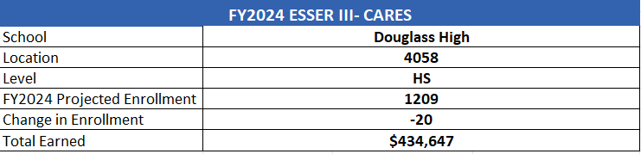
School FY24 CARES Allocation
Example
In addition to a General Fund allocation, our school has been allocated CARES funding that must be used to support implementation of the school-based intervention block and other school-based needs as a result of the COVID-19 Pandemic.
Once the support needed to implement our school-based intervention block/course has been fulfilled, we can use the remaining CARES funds to address other school-based needs that are a result of the COVID-19 Pandemic.
Notes:
Please add your school’s CARES Allocation to this slide.

Slide 15
CARES Allocations
Other allowable CARES expenditures include:
Technology Support: Software, assistive technology, online learning platforms, subscriptions.
Mental and Physical Health: Cover the costs of additional counseling, telehealth, therapeutic services, and wraparound services and supports (contracted hours, professional learning, programs)
Supplemental Learning: Cover costs of remediation, and/or enrichment opportunities during the school year for students (afterschool programs, additional pay for teachers and staff, transportation).
Professional Development: Cover costs of additional professional development for school leaders, teachers, and staff (trainings, extended professional development days, consultants, programs).
At-risk Student Populations: Cover costs of school specific activities, services, supports, programs, and/or targeted interventions directly addressing the needs of low-income students, SWD, racial & ethnic minorities, ELL, migrant & homeless students, and students in foster care.
Continuity of Core Staff and Services. Restore any potential LEA FY22 budget reductions due to decreased state and/or local revenue.

Slide 16

Questions?
Thank you for your time and attention.
Notes:
IF YOU FEEL YOUR TEAM IS READY TO APPROVE THE DRAFT BUDGET, PLEASE DO SO. PLEASE REMIND THEM THAT YOU MAY NEED TO MEET WITH THEM AGAIN, IF THERE ARE CHANGES FROM YOUR MEETINGS WITH DISTRICT LEADERSHIP. LET THEM KNOW YOU WILL KEEP THEM INFORMED!!

Slide 17
(South Atlanta Budget Feedback Discussion
To be presented to GO Team BEFORE the school staffing conference

Slide 18
Budget Feedback Meetings
What
The GO Team feedback session(s) should be scheduled for the principal to provide an overview of the school’s draft budget for the GO Team members and the general public.
Why
This meeting provides an opportunity for GO Teams to discuss how the school’s budget has been allocated to support the programmatic needs and key strategic priorities.
When
Meetings must be held in February before staffing conferences. May be combined with the allocation meeting (as needed), if the GO Team has completed strategic plan updates and ranked strategic priorities.
Notes:
Looking for general consensus prior to Staffing Conferences

Slide 19
FY24 Budget Parameters
FY24 School Priorities | Rationale
Maintain lower class sizes in the primary years by funding parapros in 1st and second grade | 47% mobility rate requires a great deal of teacher attention to students who enter our school throughout the year – many of which are below level.
Maximize wrap around services ie: Nurse, SSW, Counseling | This continues to be a need for our students, but we need to look closely at maximizing our budget to make this work.
Increase Reading/Lexiles and writing of 3rd – 5th grade students. How can we restructure our program to achieve this? | Data indicates that students who have been with us for more than one year have greater performance levels than students who are transient. With 47% of our students coming and going, there is a need to target these students.
Example
Notes:
Review the priorities that the GO Team has developed and the rationale for these priorities. Feel free to copy this slide if you have more than 3 priorities to account for.

Slide 20
Descriptions of Strategic Plan
Breakout Categories
Priorities: FY24 funding priorities from the school’s strategic plan, ranked by the order of importance.
APS Five Focus Area: What part of the APS Five is the priority aligned to?
Strategies: Lays out specific objectives for schools improvement.
Request: “The Ask” What needs to be funded in order to support the strategy?
Amount: What is the cost associated with the Request?

Slide 21
FY24 Strategic Plan Break-out
Priorities | APS FIVE Focus Area | Strategies | Requests | Amount
Increase level of rigor and relevance (example- please remove) | Fostering Academic Excellence for All (example- please remove) | Implementation of guided reading training for all staff (example- please remove) | Purchase an additional Teacher (example- please remove) | $84, 134 (example- please remove)
EXAMPLE
Notes:
For the next few slides, I will show you how I have allocated the budget to support our strategic priorities.
Based on our strategic priorities and funds we received, here is a break-out of the priorities, which focus area it addresses, the strategies that will be implemented, the purchase request, which funding source was used and the amount.

Slide 22
FY24 Strategic Plan Break-out
Priorities | APS FIVE Focus Area | Strategies | Requests | Amount
Increase level of rigor and relevance (example- please remove) | Fostering Academic Excellence for All (example- please remove) | Implementation of guided reading training for all staff (example- please remove) | Purchase an additional Teacher (example- please remove) | $84, 134 (example- please remove)
EXAMPLE
Notes:
For the next few slides, I will show you how I have allocated the budget to support our strategic priorities.
Based on our strategic priorities and funds we received, here is a break-out of the priorities, which focus area it addresses, the strategies that will be implemented, the purchase request, which funding source was used and the amount.

Slide 23
Plan for FY24 CARES Allocation $(Insert Amount Here)___
Priorities | APS FIVE Focus Area | Strategies | Requests | Amount
Increase level of rigor and relevance (example- please remove) | Fostering Academic Excellence for All (example- please remove) | Implementation of guided reading training for all staff (example- please remove) | Purchase an additional Teacher (example- please remove) | $84, 134 (example- please remove)
EXAMPLE
Notes:
For the next few slides, I will show you how I have allocated the budget to support our strategic priorities.
Based on our strategic priorities and funds we received, here is a break-out of the priorities, which focus area it addresses, the strategies that will be implemented, the purchase request, which funding source was used and the amount.

Slide 24
Plan for FY24 Title I Family Engagement Funds
$15,000.00
Priorities | APS FIVE Focus Area | Strategies | Requests | Amount
Increase level of rigor and relevance (example- please remove) | Fostering Academic Excellence for All (example- please remove) | Implementation of guided reading training for all staff (example- please remove) | Purchase an additional Teacher (example- please remove) | $84, 134 (example- please remove)
EXAMPLE
Notes:
For the next few slides, I will show you how I have allocated the budget to support our strategic priorities.
Based on our strategic priorities and funds we received, here is a break-out of the priorities, which focus area it addresses, the strategies that will be implemented, the purchase request, which funding source was used and the amount.

Slide 25
Budget by Function (Required)
*Based on Current Allocation of School Budget
Notes:
I am passing out the definitions for these funding categories. You will see what makes up each category. Although the school’s total budget amount will not change, allocation per function may change depending on our conversations and school needs.

Slide 26
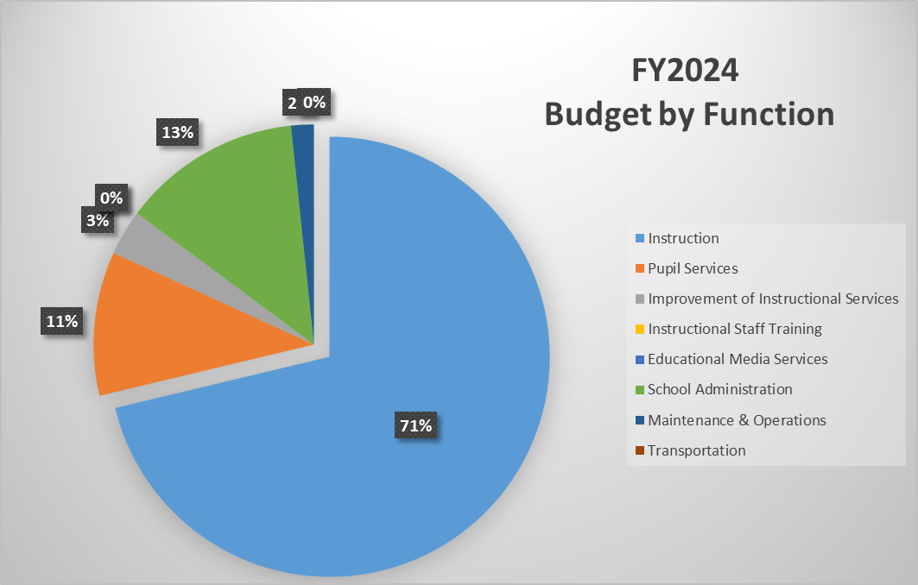
Budget by Function (Required)
*Based on Current Allocation of School Budget
Notes:
Explain the pie chart and allocations

Slide 27
Discussion of reserve and Holdback funds

Slide 28
Plan for FY24 Leveling Reserve
$__(Insert Amount Here)___
Priorities | APS FIVE Focus Area | Strategies | Requests | Amount
Increase level of rigor and relevance (example- please remove) | Fostering Academic Excellence for All (example- please remove) | Implementation of guided reading training for all staff (example- please remove) | Purchase an additional Teacher (example- please remove) | $84, 134 (example- please remove)
EXAMPLE
Notes:
For the next few slides, I will show you how I have allocated the budget to support our strategic priorities.
Based on our strategic priorities and funds we received, here is a break-out of the priorities, which focus area it addresses, the strategies that will be implemented, the purchase request, which funding source was used and the amount.

Slide 29
Plan for FY24 Title I Holdback $60,696
Priorities | APS FIVE Focus Area | Strategies | Requests | Amount
Increase level of rigor and relevance (example- please remove) | Fostering Academic Excellence for All (example- please remove) | Implementation of guided reading training for all staff (example- please remove) | Purchase an additional Teacher (example- please remove) | $84, 134 (example- please remove)
EXAMPLE
Notes:
For the next few slides, I will show you how I have allocated the budget to support our strategic priorities.
Based on our strategic priorities and funds we received, here is a break-out of the priorities, which focus area it addresses, the strategies that will be implemented, the purchase request, which funding source was used and the amount.

Slide 30
Questions for the GO Team to Consider and Discuss
Are our school’s priorities (from your strategic plan) reflected in this budget?
Are new positions and/or resources included in the budget to address our major priorities?
Do we know (as a team) the plan to support implementation of these priorities beyond the budget (ex. What strategies will be implemented)?
What tradeoffs are being made in order to support these priorities?
How are district and cluster priorities reflected in our budget?
Cluster priorities- what staff, materials, etc. are dedicated to supporting our cluster’s priorities?
Signature programs- what staff, materials, etc. are dedicated to supporting our signature program?
Are there positions our school will share with another school, i.e. nurse, counselor?
Notes:
CHAIR - Our final task for today! Here are questions that we need to consider to ensure we have a good working draft budget. Let’s walk through them together.

Slide 31
Where We’re Going?
Our next meeting is the Budget Approval Meeting
What:
During this meeting we will review the budget, which should be updated based on feedback from the staffing conference, Associate Superintendents, and key leaders. After review, GO Teams will need to take action (i.e., vote) on the FY24 Budget.
Why:
Principals will present the final budget recommendations for GO Team approval.
When:
All approval meetings must be held after staffing conferences. Budgets must be approved by March 17th.

Slide 32
What’s Next?
February
  HR Staffing Conferences (Late February)
March
  Final GO Team Approval Meeting (AFTER your school’s Staffing Conference and BEFORE Friday, March 17th)
Notes:
In February, we will meet again to discuss how the school’s budget has been allocated to support the programmatic needs and FY23 key strategic priorities.
If think we need to continue our budget conversations, we will schedule additional meetings. My goal is to make sure your voices are reflected in our school’s budget.
I will also be meeting with my Associate Superintendent, program managers and other key leaders to go over our budget and to make sure the school is meeting the standards of service and appropriately staffing.
During the week of Feb. 24th -March 2nd , HR Staffing Conferences will be held. At this meeting, I will present my plan for staff utilization, resource distribution and plan for staffing implications.
We will need to approve the budget at the ________ meeting.

Slide 33
Thank you

Slide 34
Overview of FY ‘24 GO Team Budget Process
Step 1 Review and Update Strategic Plan and Rank Strategic Priorities
By end of Fall Semester
Step 6 Principals: HR Staffing Conferences Begin
Late February – Early March
Step 3 GO Team Initial Budget Session: Allocation
January 24 – early February
Step 7 GO Team Final Budget Approval Meeting
Budgets Approved by March 17
Step 5
GO Team Feedback Session: Draft Budget Presented & Discussed February – multiple meetings, if necessary
Step 4 Principals: Associate Supt. Discussions and Review
February (supports needed, specific challenges, coaching)
Step 2 Principals: Workshop FY 24 Budget
January 24
GO Teams are encouraged to have ongoing conversations

